Slide 1
Facilitating Discussions in an Online Classroom:
a practical approach

Slide 2
Agenda
Discussions are Opportunity
Discussions Matter
Facilitator Introduction
Common Challenges
Todd’s Top Ten
Q&A

Slide 3
Discussions are opportunity for instructors…
To build community and connect with students
To share expectations
To set the tone
To build lasting impressions
To demonstrate expertise
To model the process of inquiry
To teach

Slide 4
Discussions are opportunity for students…
To build community
To engage with instructors and peers
To build lasting impressions
To network
To demonstrate understanding and competency
To engage in healthy discourse
To work in teams
To debate
To plan
To learn

Slide 5
Discussions are not (or should not be)
Filler
Busy work
Insignificant

Slide 6
Discussions Matter!
Research points to both student satisfaction and knowledge acquisition!

Slide 7
Discussions Matter!
Students Enjoy (in descending order):
Online Discussions
PowerPoint Presentations
Research Papers
E-mail Correspondence
Essays
Viewing Videos/Movies
Blogging
Viewing Webinars

Slide 8
Discussions Matter!
Instructors and students clearly indicate that seven activities best helped students retain knowledge:
Online Discussions (85.5%)
Essays (81%)
Research Papers (79.1%)
PowerPoint Presentations (69.1%)
E-Mail Correspondence (62%)
Group Projects (55.3%)
Viewing Videos/Movies (59.1%)
Only 6% of students did not believe that discussions aided in knowledge retention.

Slide 10
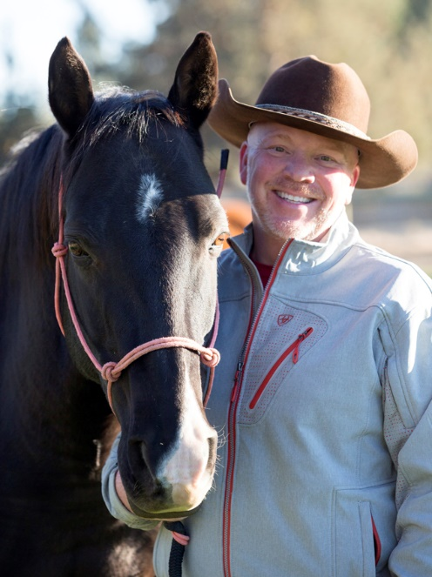
Facilitator Introduction
Professional Experience
Served as president and CEO national healthcare recruitment, Human Resources and outsourcing firm 12 years
25 years human resource and healthcare administration experience
15 years C Suite positions
Overseen public and private organizations
Employment expert
Extensive Training and Development Experience
Online teaching experience since 2009
Education
MBA – Healthcare Administration
ME.d – Organizational Leadership
MSIT – Computer Assurance and Security
Personal
Live in Central Oregon
Enjoy International Travel
Teaching is a passion

Slide 13
Common Challenges
Creating Engaging Discussions
Building Community
Staying Engaged
Keeping Students Interested
Modeling Expectations
Clarifying Expectations
Hot Button Issues

Slide 14
Todd’s Top Ten 10
Use Technology
YouTube
TedTalks
Khan Academy
YOU- Audio and/or Video

Slide 15
Todd’s Top Ten 09
Focus on Learning Objectives
Bloom’s Taxonomy
Connect to Module Material
Explain the big WHY

Slide 16
Todd’s Top Ten 08
Demonstrate Expertise
Share real world experience
Connect to career
Prove you are the expert

Slide 17
Todd’s Top Ten 07
Frame the Discussion
Announcements on expectations
Weekly Shout Outs!
Announcements as wrap ups

Slide 18
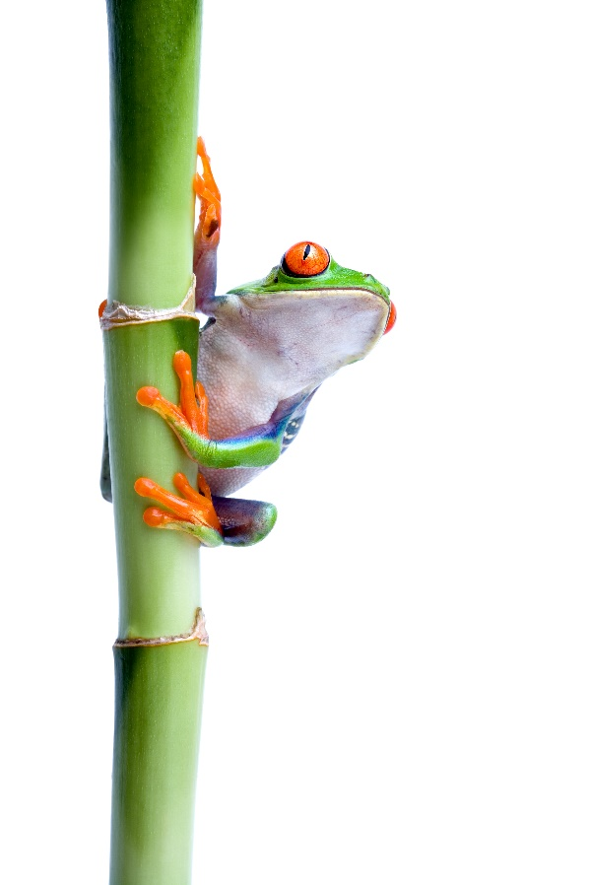
Todd’s Top Ten 06
Model the Expectations
Seed the discussion forum
Be active and present
Quality begets quality
Challenge and redirect with respect and inquiry

Slide 19
Todd’s Top Ten 05
AAR
Ask questions
Affirm understanding
Redirect

Slide 20
Todd’s Top Ten 04
Model Critical Thinking
Take the journey with the students
Engage
Push

Slide 21
Todd’s Top Ten 03
Research Matters- prove it
Do research before the class- use it- share it
Expect it
Push

Slide 22
Todd’s Top Ten 02
Say something- even when they do not!
Participate daily or set the expectation
Share resources
Current events make the learning- current!

Slide 23
Todd’s Top Ten 01
Make it personal
Welcome each and every student
Call students by name
Participate in the conversation and extend it
Thank them for their contributions

Slide 25
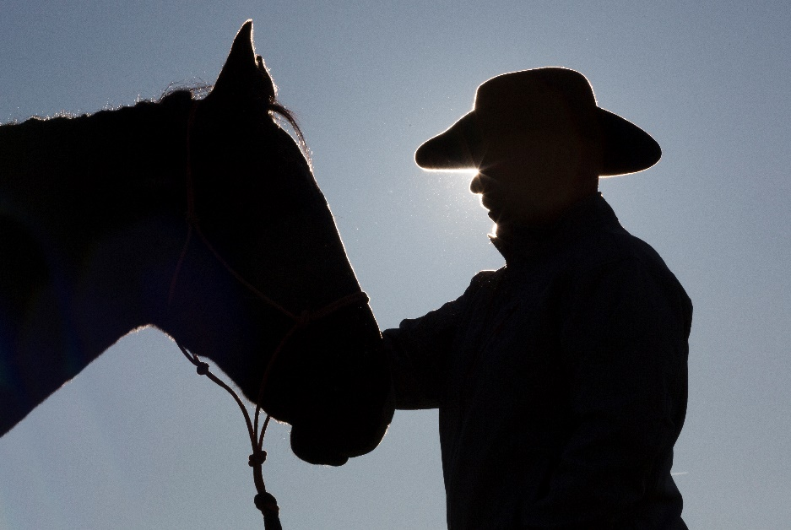
How can I help?
Todd Kane
Phone: 541.583.0178
Mobile: 505.908.1979
Skype: r.todd.kane
Email: professortoddkane@gmail.com

